Slide 1

We create better life
with pure water!

Slide 2
AS Tallinna Vesi
The Largest Water Utility in Estonia
April 2019

Slide 3
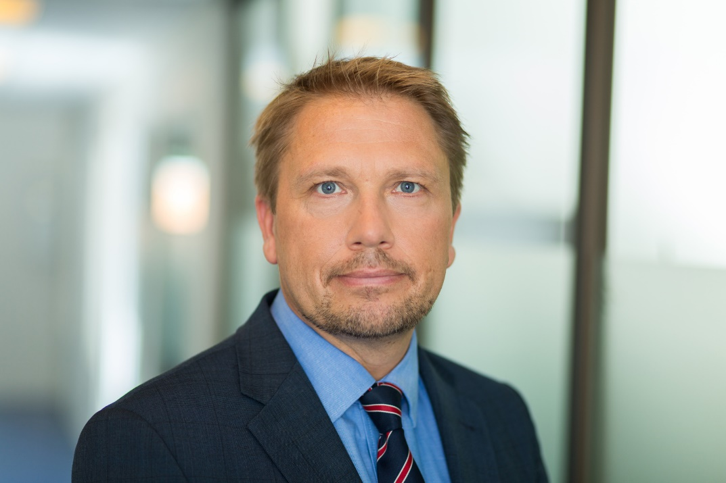
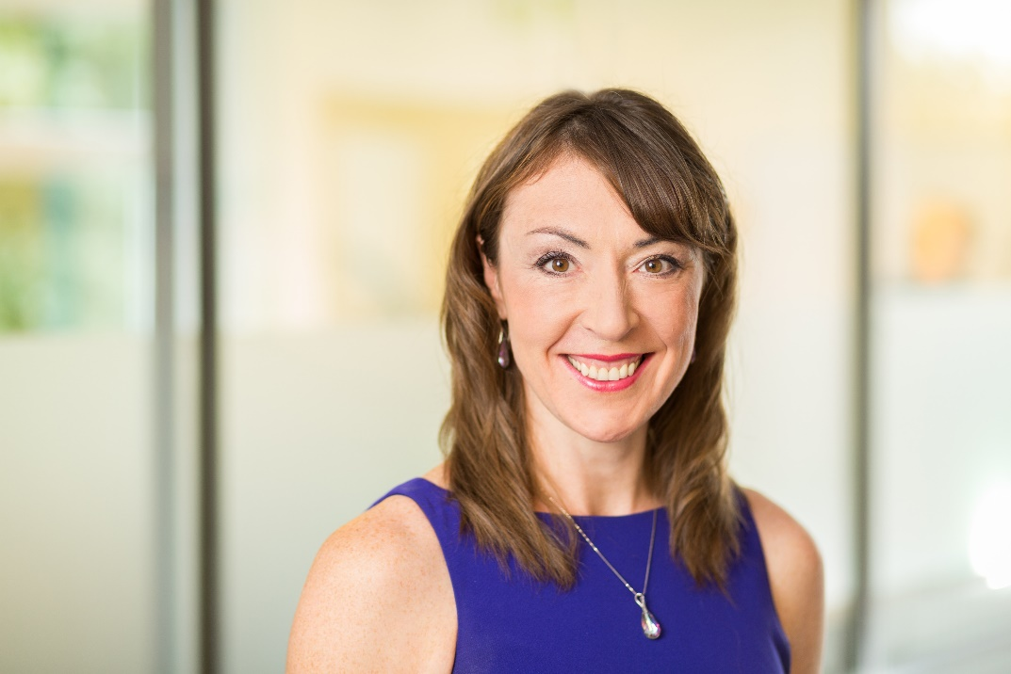
Speakers
Karl Brookes,
CEO, Member of the Management Board
Riina Käi
CFO, Member of the Management Board

Slide 4
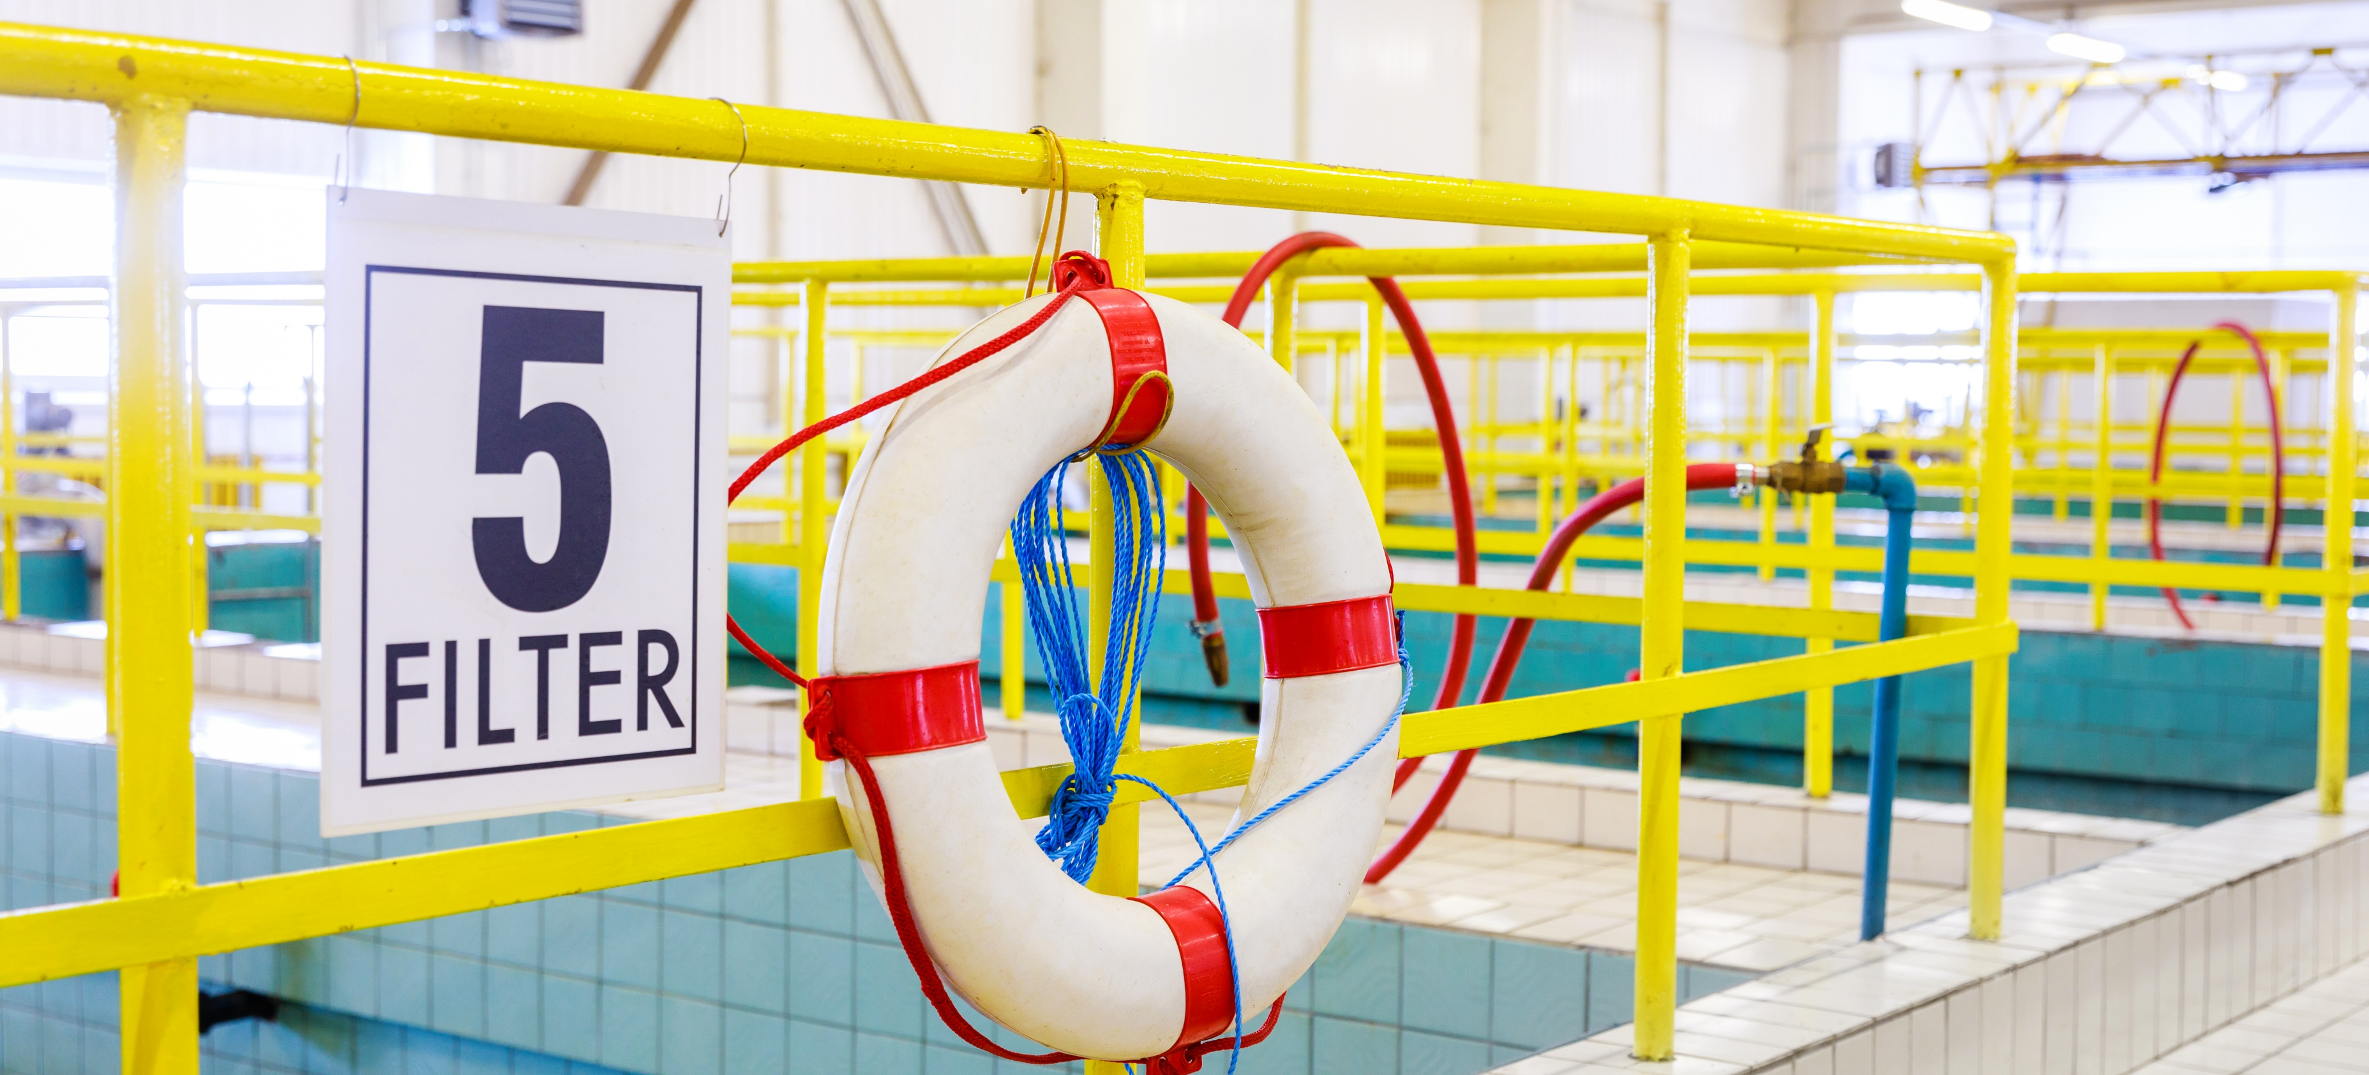
Company History and Improvements

Slide 5
Important milestones
1979
Paljassaare wastewater treatment plant was opened
14th century
Tallinn started using water from lake Ülemiste
90
Last year our Ülemiste water treatment plant turned 90. In 1927, Tallinna Filterveevärk was established
2001
majority shares of Tallinna Vesi were sold to United Utilities
2005
Shares of Tallinna Vesi were listed on the main list of Tallinn Stock Exchange
2010
Subsidiary OÜ Watercom was established
1997
AS Tallinna Vesi was registered. Single shareholder was City of Tallinn
Notes:
2005 - Tallinna Vesi is a listed company whose shares were listed on the Tallinna Stock Exchange’s main list on 1 June 2005. 30% of the company’s shares are freely transferable on the Nasdaq OMX Baltic market.
2010 – Watercom provides the following services: construction and desgn of pipes, road maintanance and construction, Project management and owner´s supervision, jet washing and transportation.

Slide 6
Customers and Operating Area
460 000
end users
23 600
customers
1/3
Of Estonia´s population

Slide 7





Responsible for the whole value chain
Catchment
Water treatment
Water distribution
Sewage collection
Wastewater treatment

Slide 8
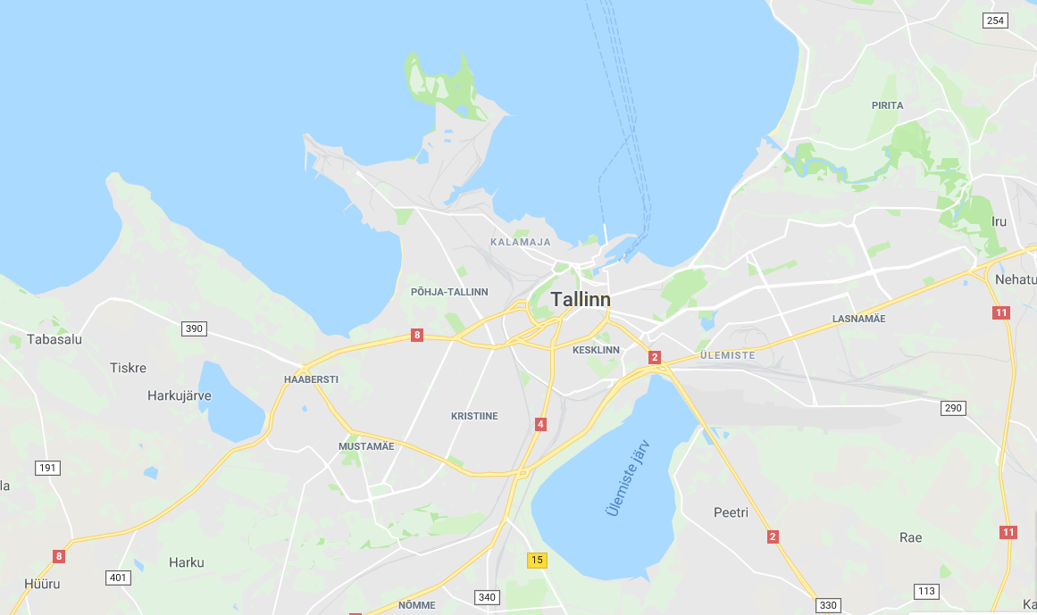

PALJASSAARE WWTP
Capacity 360 ML/day
Current treatment 150 ML/day
ÜLEMISTE WTP
Capacity 120 ML/day
Current production 60 ML/day

Slide 9
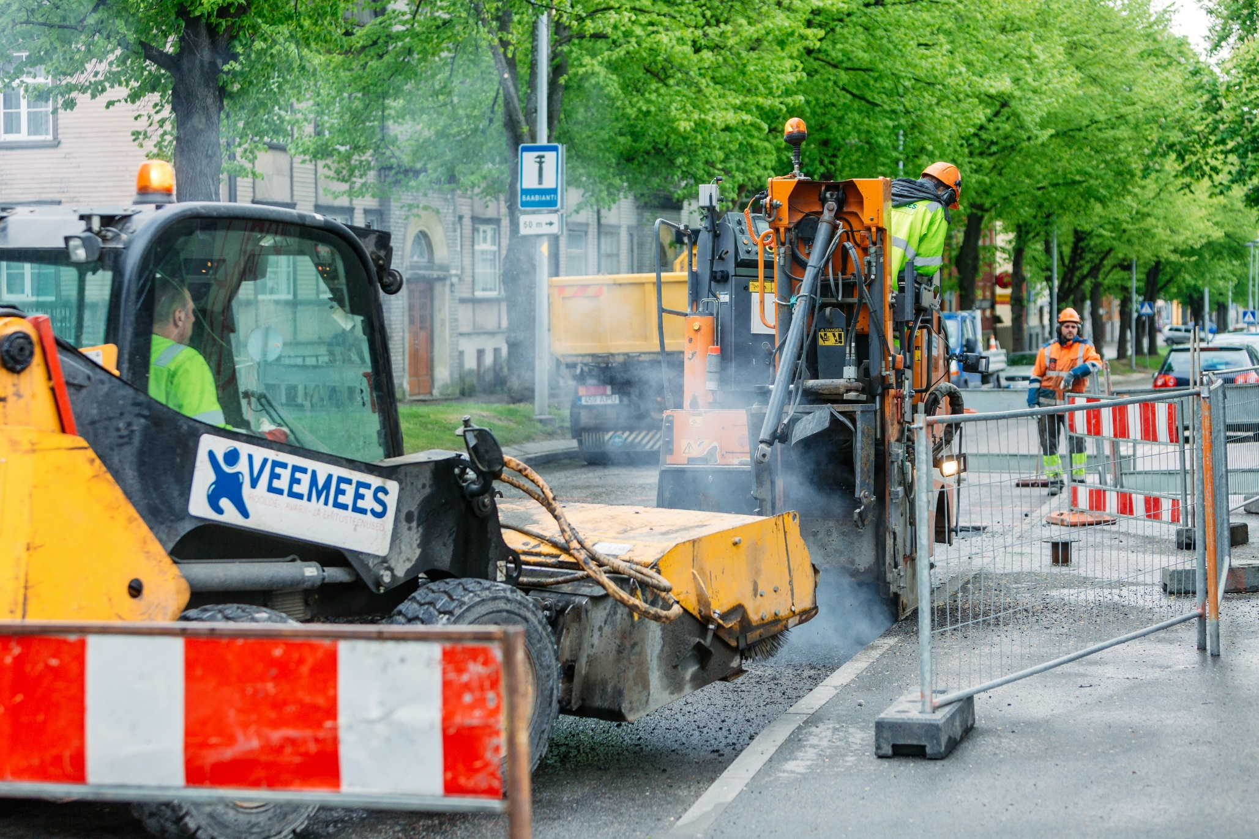
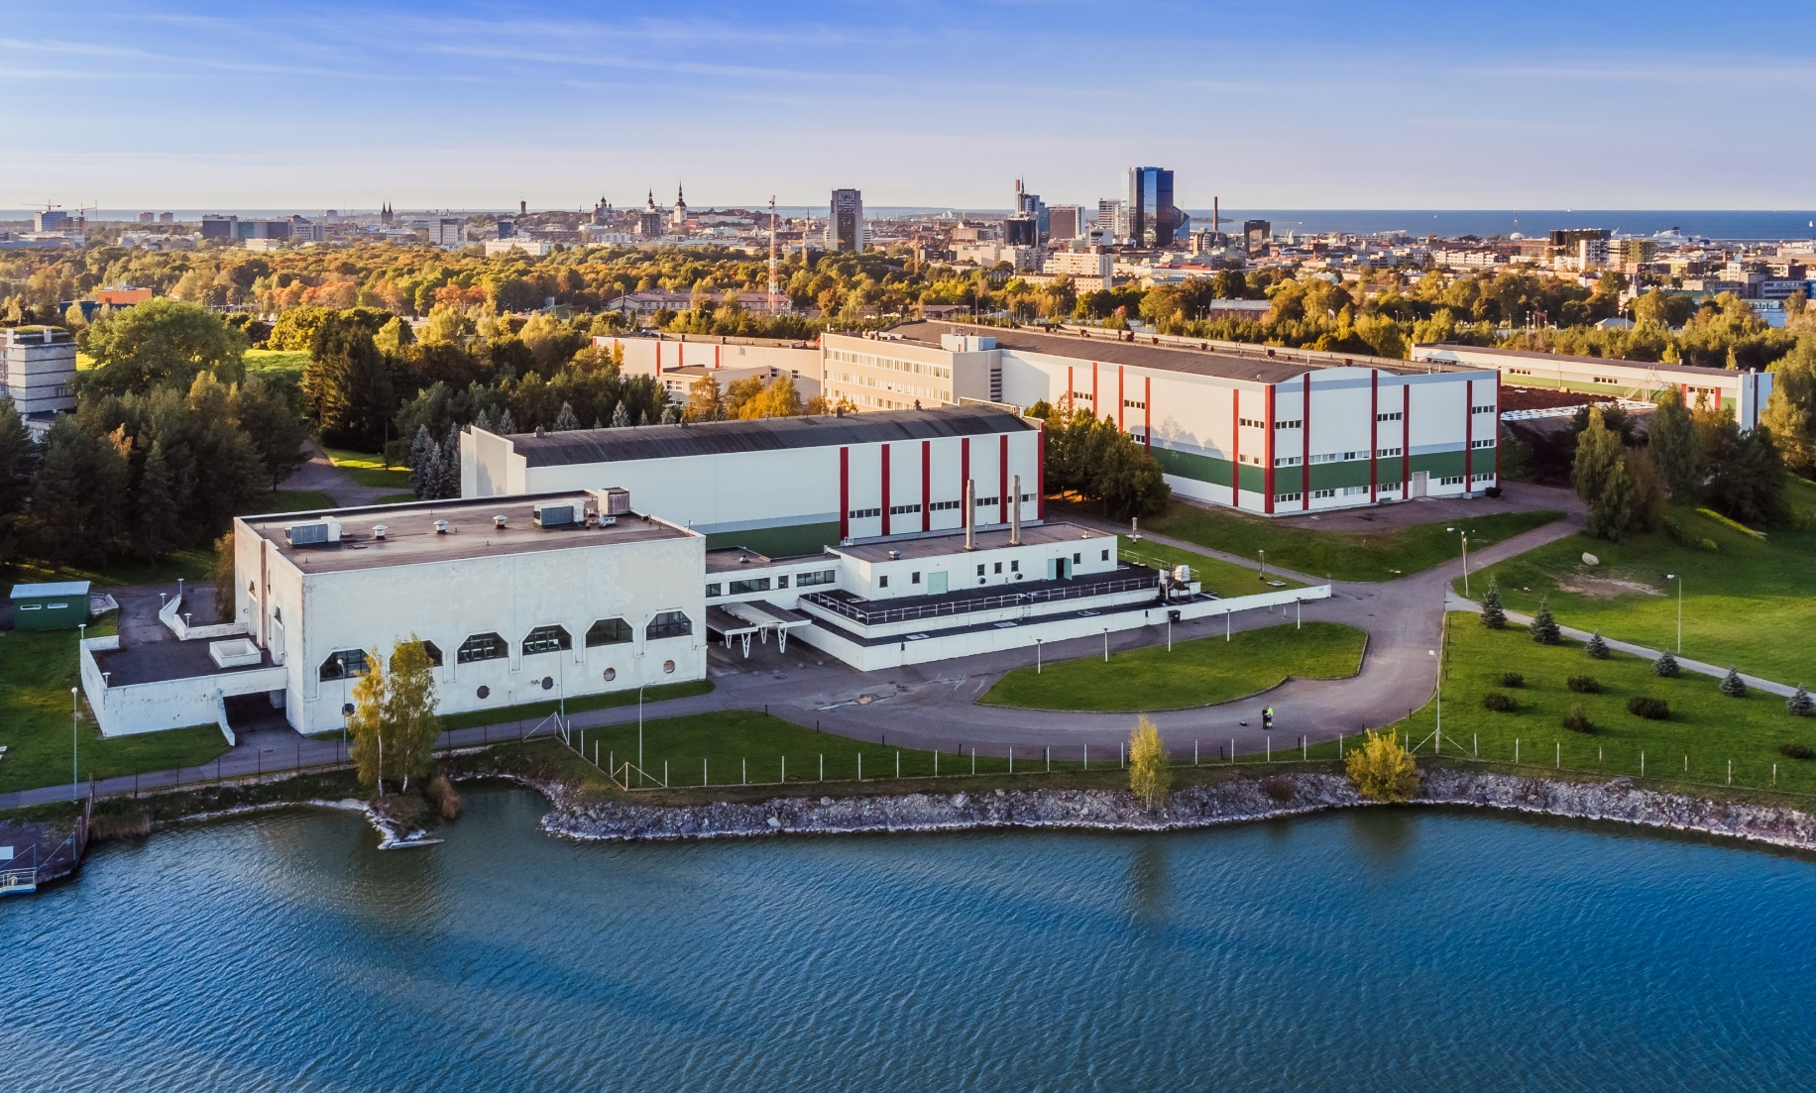
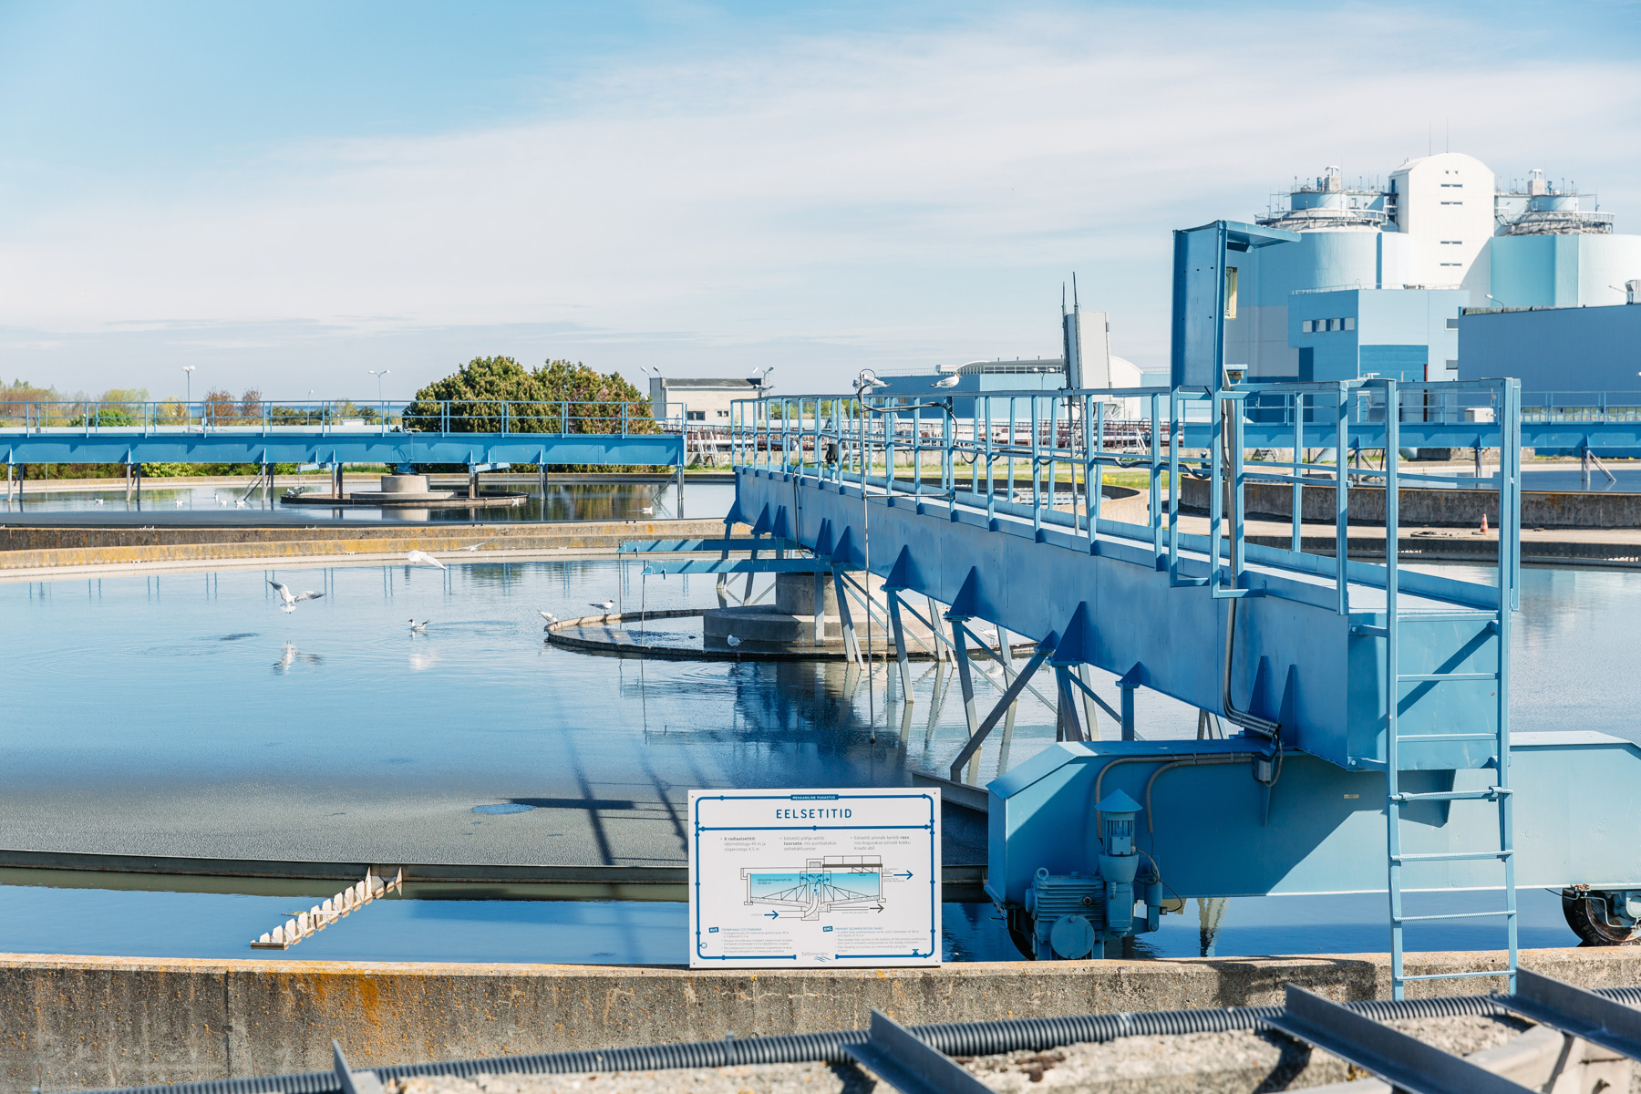
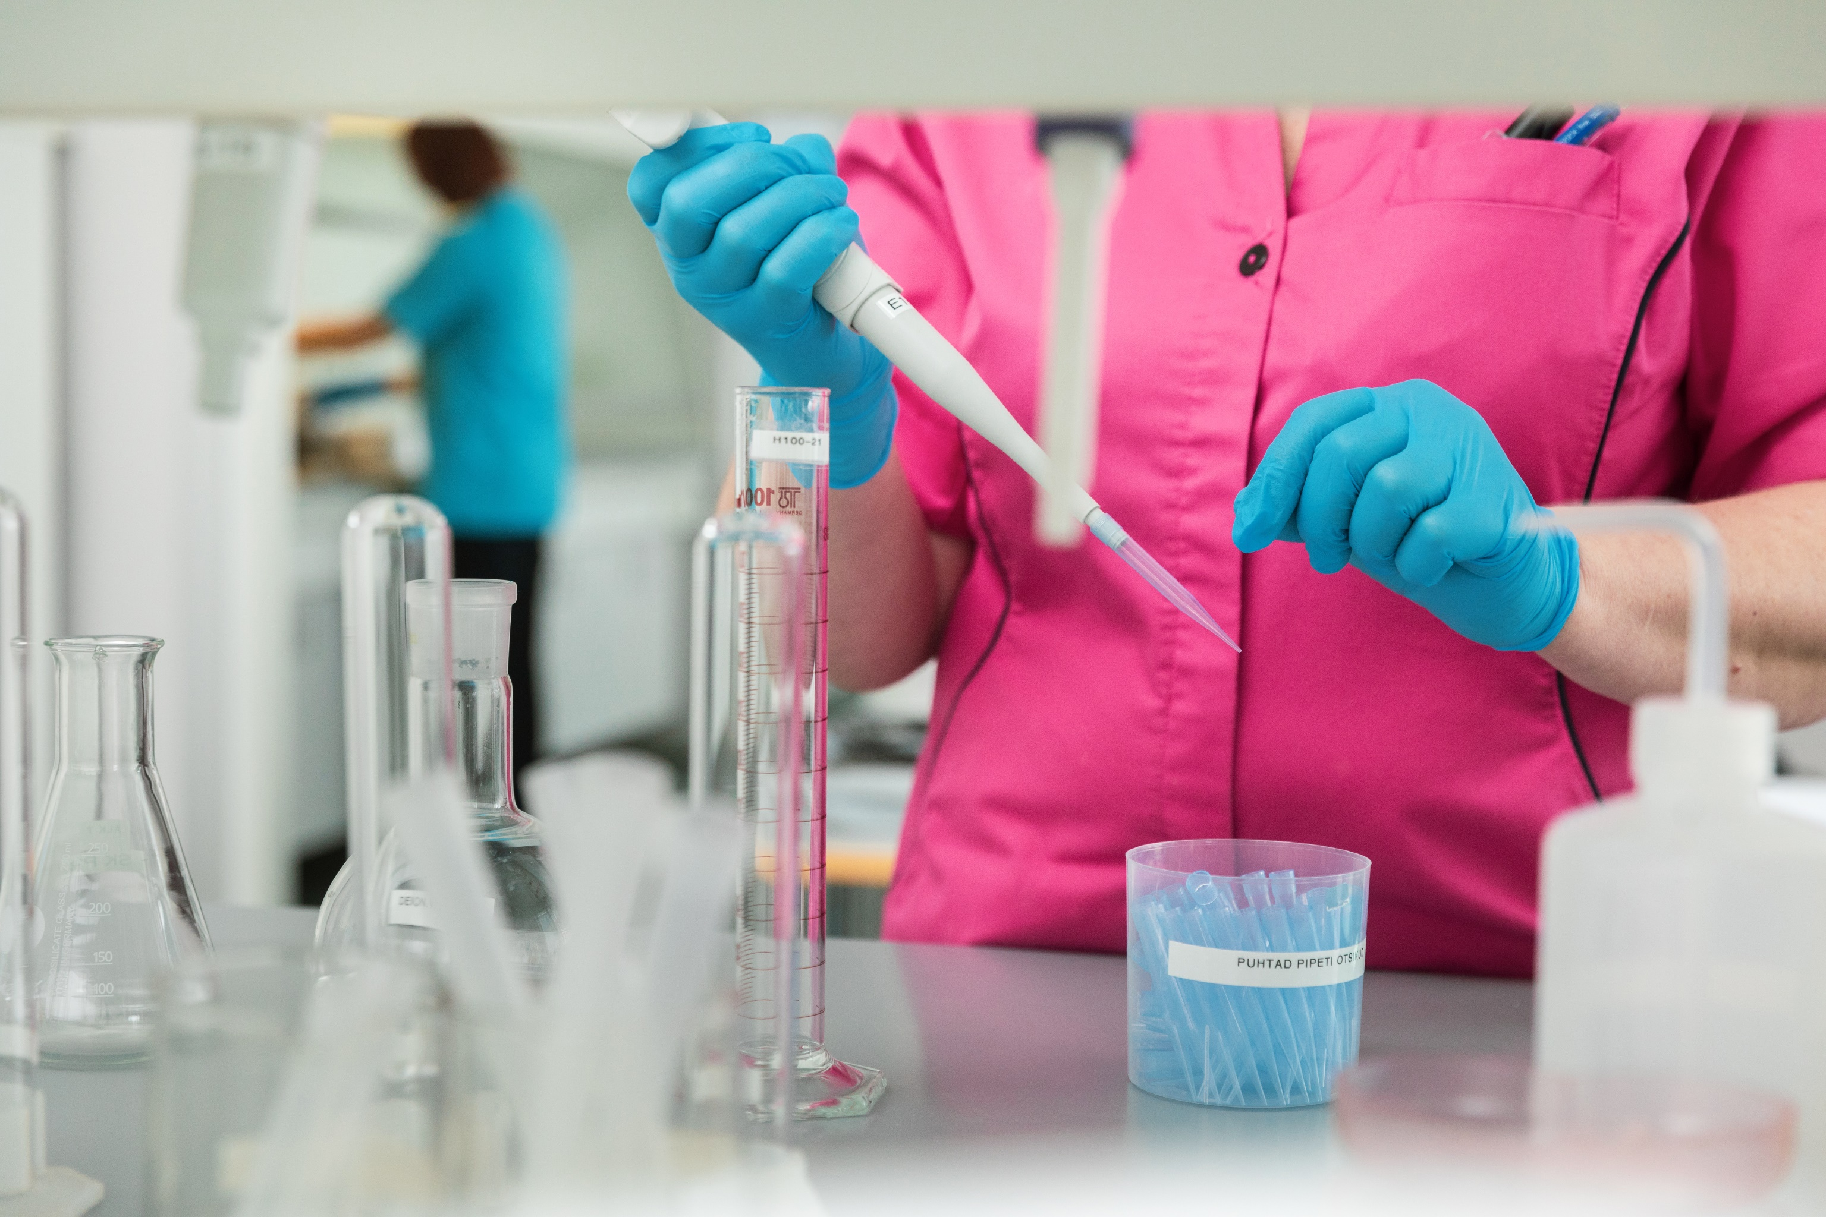
OÜ Watercom pakub torustike ehituse, asfalteerimise ja teiste vee- ja kanalisatsiooniteenuse osutamisega seotud teenuseid.
Notes:
Siin saab rääkida, et lisaks vee- ja reoveepuhastusele on akrediteeritud laborid ja tütarettevõte Watercom.

Slide 10
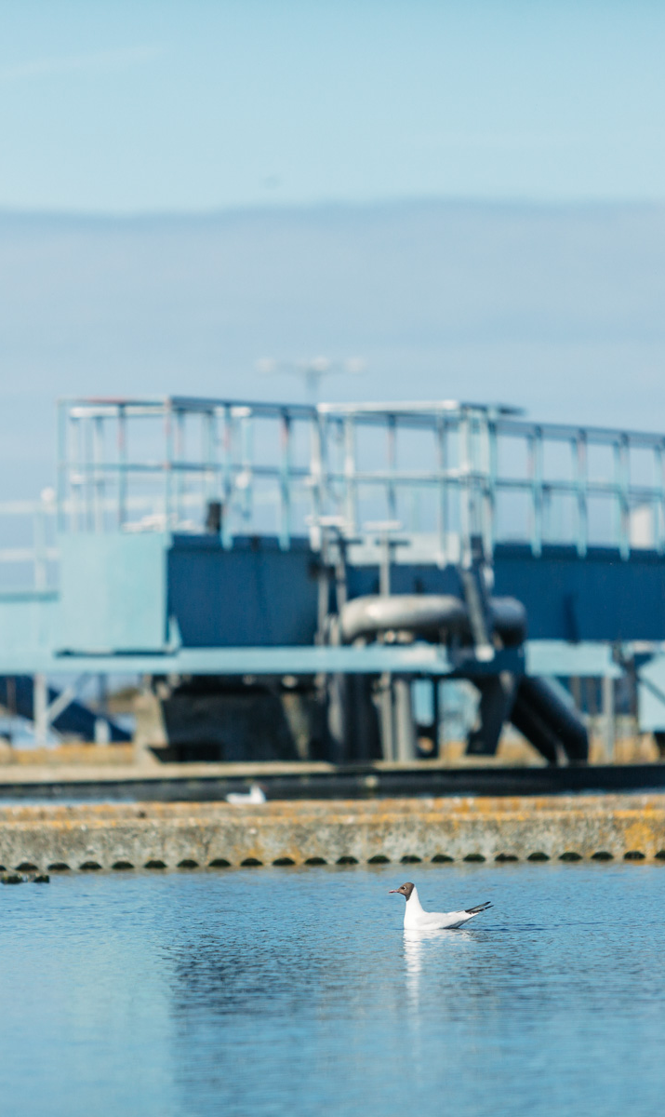
Privatisation and IPO
15 year contract
Approved by all relevant Governmental bodies
Full support of EBRD, release of State guarantee
Exclusive right to operate in the area
60% lowest tariffs increase
Remarkable increase in quality to meet EU standards;
40% highest price paid for the shares (129% premium paid to City of Tallinn)
AS Tallinna Vesi is the asset owner
Privatisation
terms
2005 IPO
Privatisation contract key element in IPO circular
Listing price 9,25 €

Slide 11
Shareholders of Tallinna Vesi
United Utilities Tallinn B.V Shareholders 100% United Utilities
International and local investors
Investor base
International institutional ~ 5.97%
Estonian institutional ~ 6.37%
Retail ~ 17.66%
Notes:
Investor base
International institutional ~ 5.9%
Estonian institutional ~ 6.7%
Retail ~ 17.4%

Slide 12
Low operating risk, sustainable quality
ISO 9001, 14001 and 17025 accreditation
EU EMAS certification and OHSAS 18001
Full compliance with 97 Levels of Service 2001 - 2018
    minor non compliance in one LoS due to extraordinary conditions
Services
contract
environment
certificates
Water and wastewater quality fully compliant with Estonian and EU regulations
Proven business continuity and disaster management plans are in place
W and WW
services
Risk
management

Slide 13



Operational results throughout the years
99.93%
31.64%
20
61.98%
13.71%
0
1,654
2,090
54%
86%
603
475

Slide 14

Affordable service
          Estonian average, lower compared to Western-Europe and Scandinavia
W AND WW
TARIFFS
AFFORDABLE
SERVICES
Tariffs should not exceed 4% of net disposable income (In Tallinn 0.95%)

Slide 15
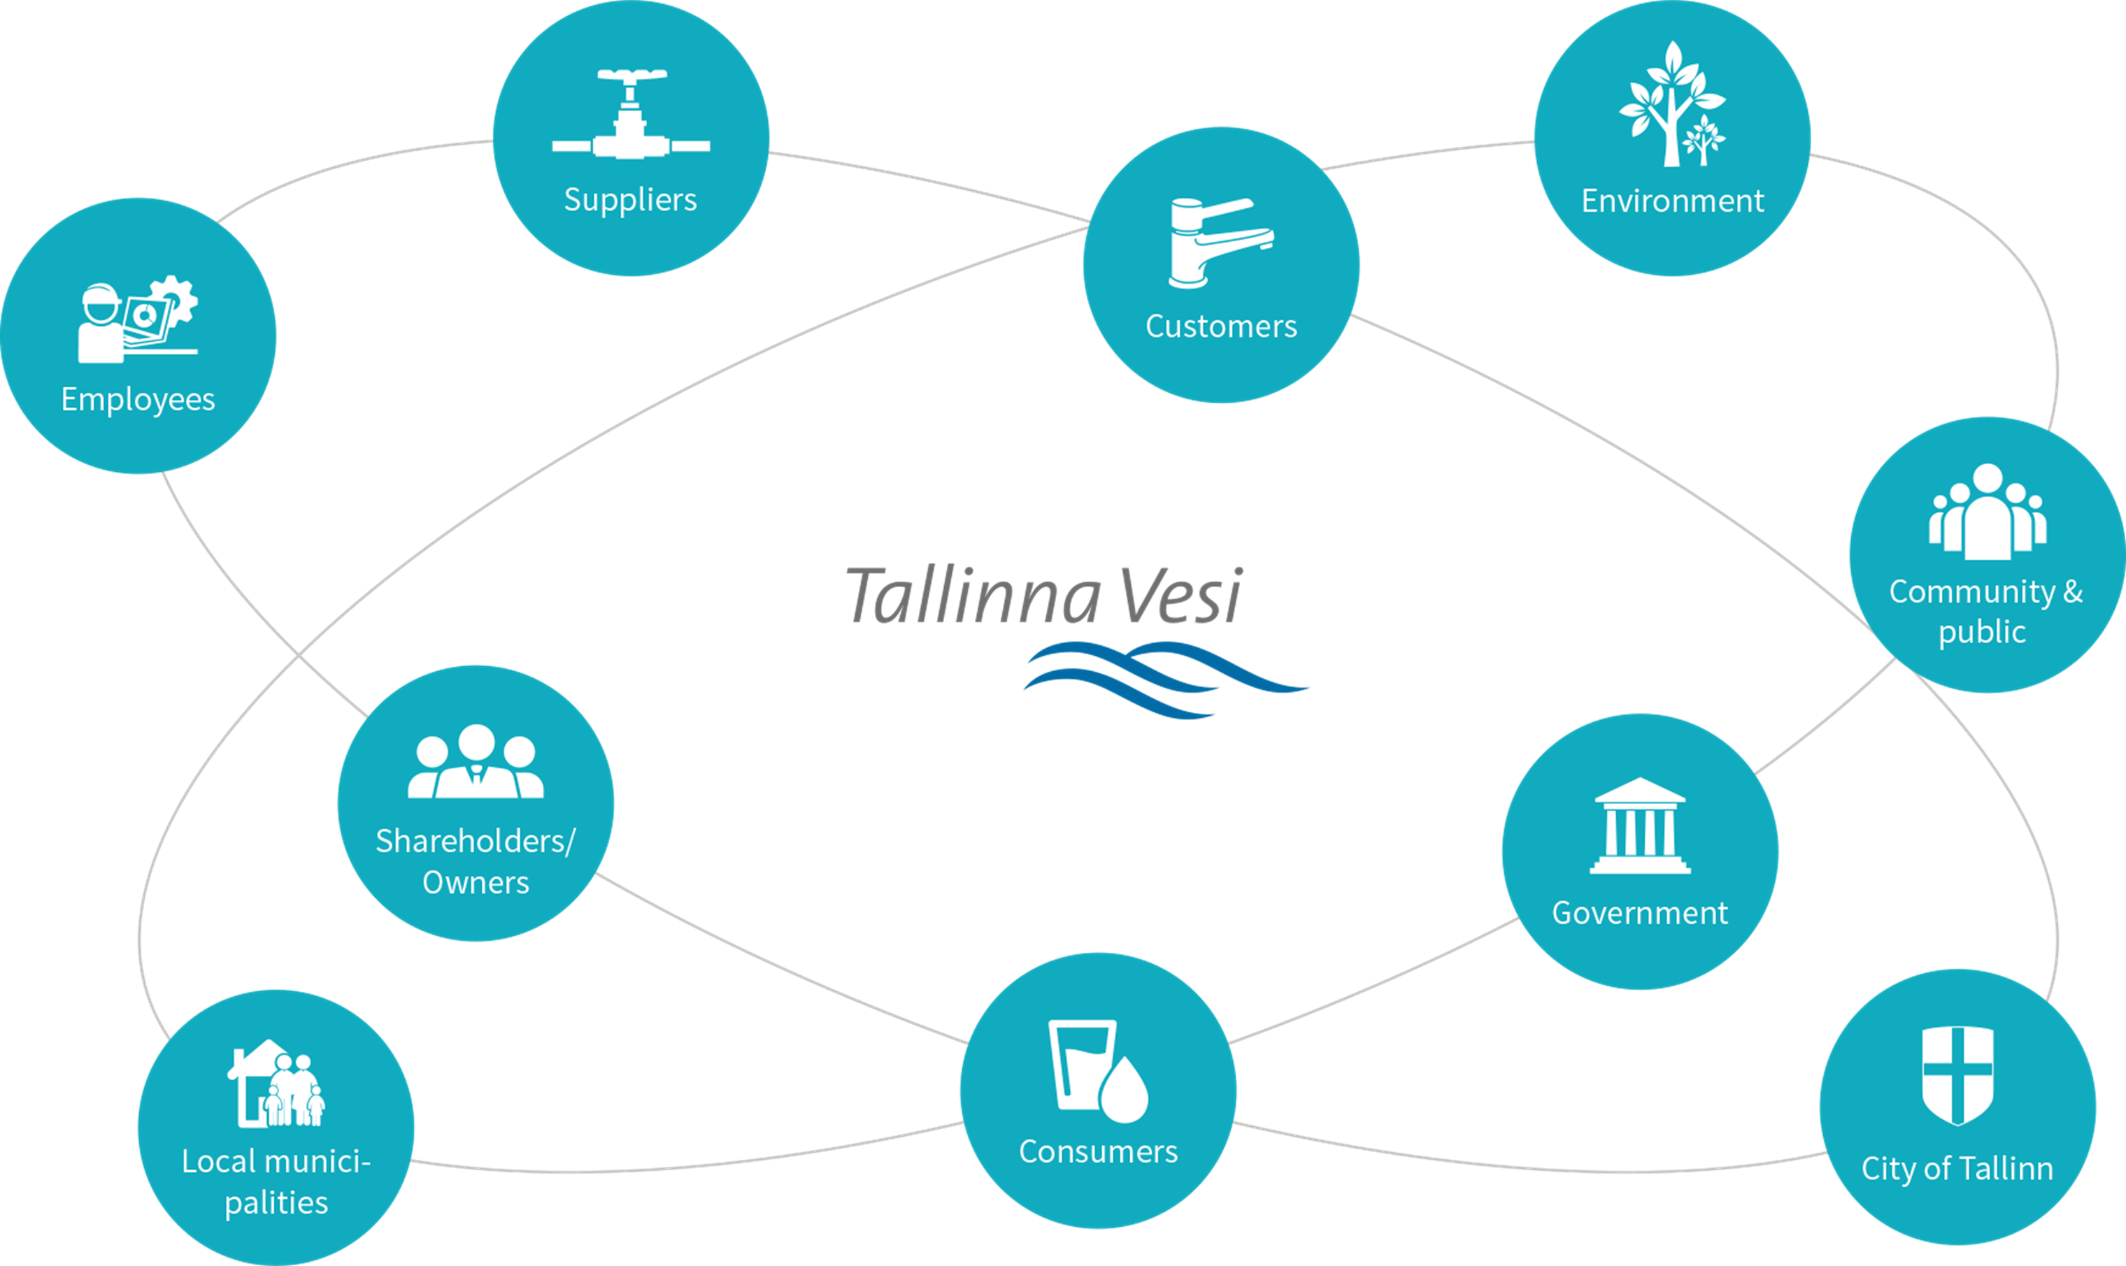
Notes:
Stakeholders of Tallinna Vesi

Slide 16
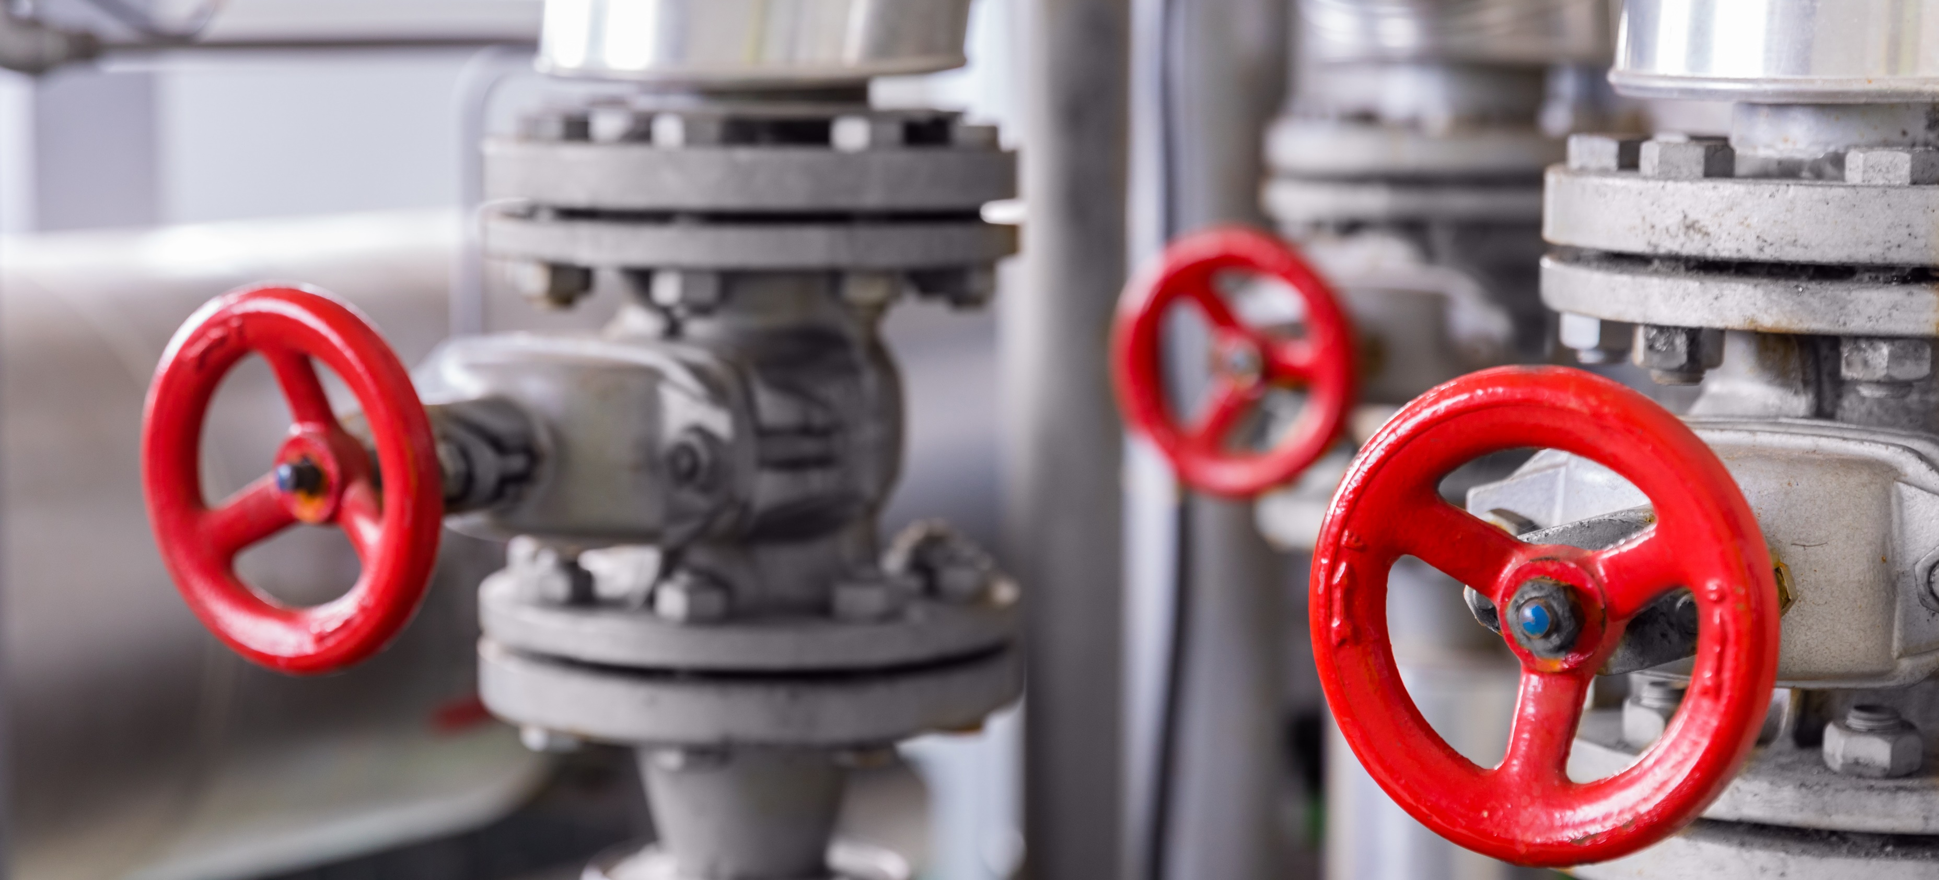
PRIVATISATION CONTRACT DISPUTE

Slide 17
Background of privatisation agreement
Legal provisions
Financial provisions
Exclusive right to operate for 20 years till 2020
97 levels of service requirements - quality driven, investments requirements, penalties for non-compliance City of Tallinn step in rights and right to terminate the agreement in case of failure to remedy material default
      Monitoring by Supervisory Foundation
      International arbitration for main disputes
Overall tariff mechanism until 2020 and tariff agreement until 2020
Mechanism for reimbursement by City of Tallinn for networks extension
Sub-agreements to SA determine payments by City of Tallinn for storm water and fire hydrant services
Separate tariffs for water and waste water services as well as for residential and commercial customers

Slide 18
Long term visibility by tariff in PA
T∆ = K + CPI +LAW
TARIFF REVIEW
K-FACTOR
CPI CHANGES
CHANGES IN THE LAW
Contractual agreement until 2020
Simple and effective tariff mechanism
Reflects changes in necessary operating expenses and investments
2011- 2020 0%
Annual adjustment for inflation
Impact of adverse change of law can be recouped through tariff
Increase only CPI from 2010-2020 as agreed in the services agreement.

Slide 19
Changes in the regulation from 2010
2001 - 2010 City of Tallinn
From 1st November 2010 Competition Authority
Long term contract
Price cap regulation
Company is motivated in efficiencies
12 months regulatory period
New limits to the capital invested by the water undertaking
Single rate of return on NBV, annual cost review
All efficiency gains would be taken away next year
No liability nor interest to regulate quality aspects of the service
No appeal mechanism except from Court
19

Slide 20
CA tariff methodology
T∆ = COSTS + CAPITAL COMPONENT +ALLOWED PROFITABILITY
COSTS
CAPITAL COMPONENT
ALLOWED PROFITABLITY
Allowed costs are reviewed in one year perspective taken into account past 3 years performance;
Costs for doubtful receivables, fringe benefits, dividend income tax etc are not allowed
Depreciation on the cost value of assets
Revaluations are not allowed
Sometimes shorter periods can be used
Calculated from the historic NBV value
WACC in 2018 is 5.45%

Slide 21
Highlights of the tariff dispute local
November 2010 contractual tariff application
On 2nd May 2011 the CA refused to approve the ASTV’s tariff increase for 2011. CA has refused to approve all the following applications on annual tariff increase allowed under the SA
October 2011 prescript for 29% tariff cut
February 2012 interim injunction
Tariff mechanism is administrative agreement
Closed proceedings as per CA applications
3 Court hearings in 2015
ASTV submitted a damages claim (over 90 million euro) to avoid expiry of damages claim under the national law in May 2014.
In June 2015 the court dismissed ASTV’s complaint in tariff dispute against CA. The Company appealed at the end of 2015.
December 2017 lost the cassation in Supreme Court
4th December 2018 CA did not approve the tariff application and 12th February 2019 CA refused the challenge from 3rd January 2019. 13th March the Company challenged it in Administrative Court
6th December 2018 CA announced of possible Supervisory proceedings to which the Company has time to reply till 1st April 2019. The Company must reply by 23rd April 2019
21
Notes:
(review of the damages claim is suspended until the main dispute is resolved)

Slide 22
Highlights of the tariff dispute ICSID
In Oct 2014 ASTV commenced International arbitration proceedings against the republic of Estonia
Hearings in November 2016.
Arbitration still ongoing and award is expected on 3rd May 2019.
22
Notes:
(review of the damages claim is suspended until the main dispute is resolved)

Slide 23

SOLID FINANCIAL PERFORMANCE

Slide 24
Financial strengths
Captive and balanced customer base
Organic growth opportunities
Predictable
Sales, Strong
Customer
BASE
Profits
Converted
To cash flow
Very high collectability rate, over 99%
Strong balance
Sheet
High quality
Asset base
Asset owner
Main investments have been made to improve the performance

Slide 25
Revenues, operating and net profit

Slide 26
Profit margins

Slide 27
Profits converted to cash flow
Due to excellent debt collection profits transformed to cash flow
    Average debt collection rate was 99.73% in 2018

Slide 28
High quality asset base
Main investments made to improve the quality of assets
    Capex 2001-2018 ~ 141 m’€
*CAPEX does not include network extensions reimbursable by the City of Tallinn and developers
28

Slide 29
Strong balance sheet
Efficient Capital Structure
    Debt to assets target between 55%-65%
Long term loan liabilities 95 m’€
Interest cover 2018 ~ 20.0
Net debt to EBITDA ~ 2.0
29

Slide 30
Debt structure
Total loan capital 95 mln €
    Weighed average interest risk margin 0.79%
    All loans with floating interest rate
    47% fixed with interest rate swaps

Slide 31
Business focus
Customers and Society
Customer awareness and satisfaction
Community
Environment
Finance and Business Impact
Maintaining the profitability and efficiencies
Maintaining healthy dividends
Tariff disputes and contractual matters
Additional possible revenue streams
Financing of the company, CAPEX and working capital management
Continuous improvement
Employees
Employee engagement and satisfaction
Health & Safety
Succession planning
Operations
High quality water and wastewater services
Meeting all 97 levels of services
Investing into assets based on asset maintenance plan

Slide 32
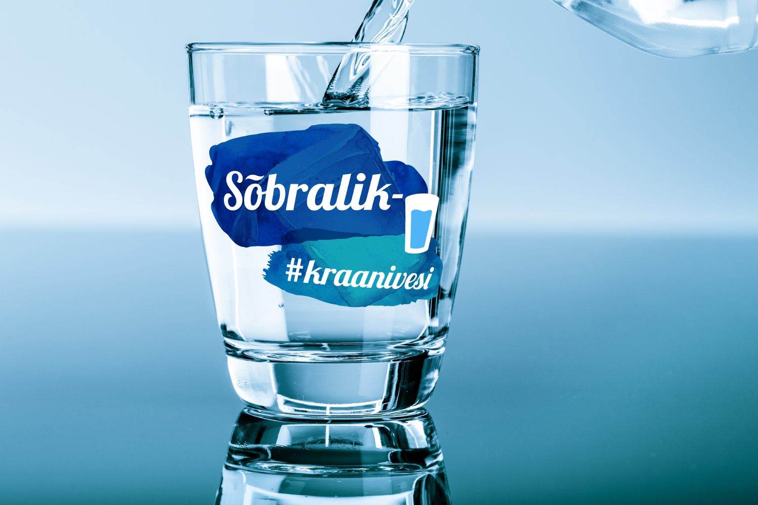
Thank you!

